Slide 1
OS Introduction 3 Computer Architecture
David Liu
Spring 2022, Fall 2024

Slide 2
Learning Objectives
Discuss the role and importance of operating systems
Describe the general organization of a computer system and the role of interrupts
Describe the components in a modern, multiprocessor computer system
Illustrate the transition from user mode to kernel mode
Discuss how operating systems are used in various computing environments
Provide examples of free and open-source operating systems

Slide 3
Review Questions
Think about what kinds of interrupts there are? Are all interrupts equally important?
Describe a interrupt vector table design
How often CPU check interrupts?
How does interrupt handling affect system performance?

Slide 4
Computer-System Architecture
Single-Processor Systems
Multi-Processor Systems
Clustered Systems

Slide 5
Single vs Multiprocessor System
# of General-Purpose Processor

Slide 6
Multiprocessor Systems
Symmetric multiprocessing
Shared physical memory with bus
Interconnected Multiprocessors
non-uniform memory access (NUMA)

Slide 7
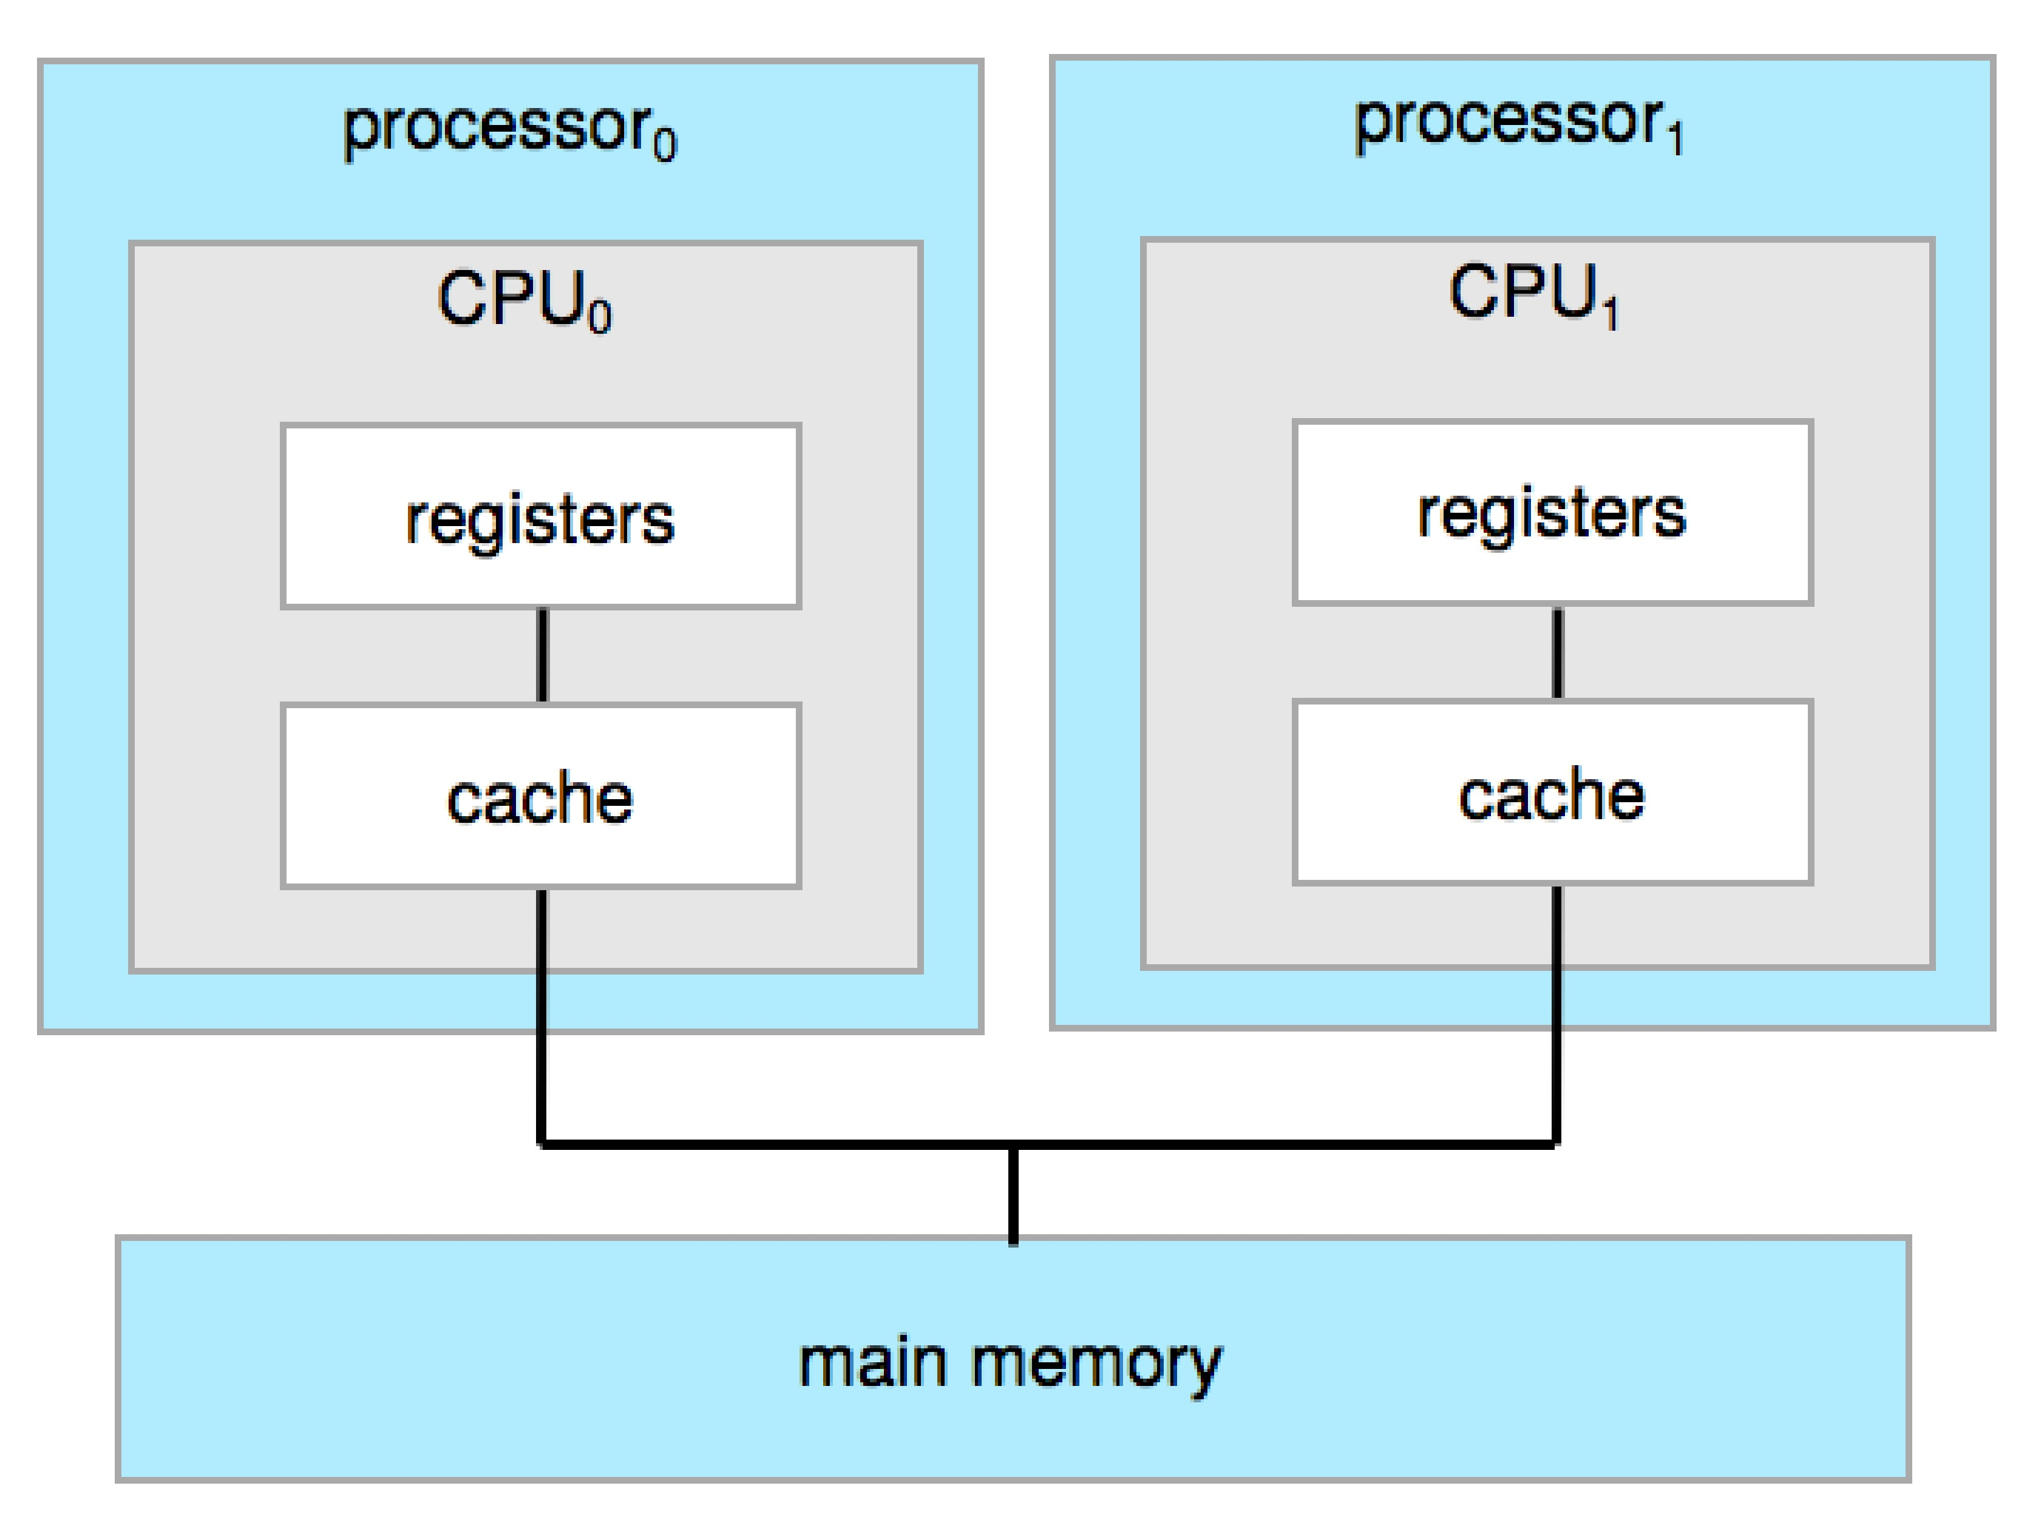
Multiprocessors
Symmetric Multiprocessing
Asymmetric Multiprocessing
Not all processors are treated equals
e.g. only one CPU runs OS

Slide 8
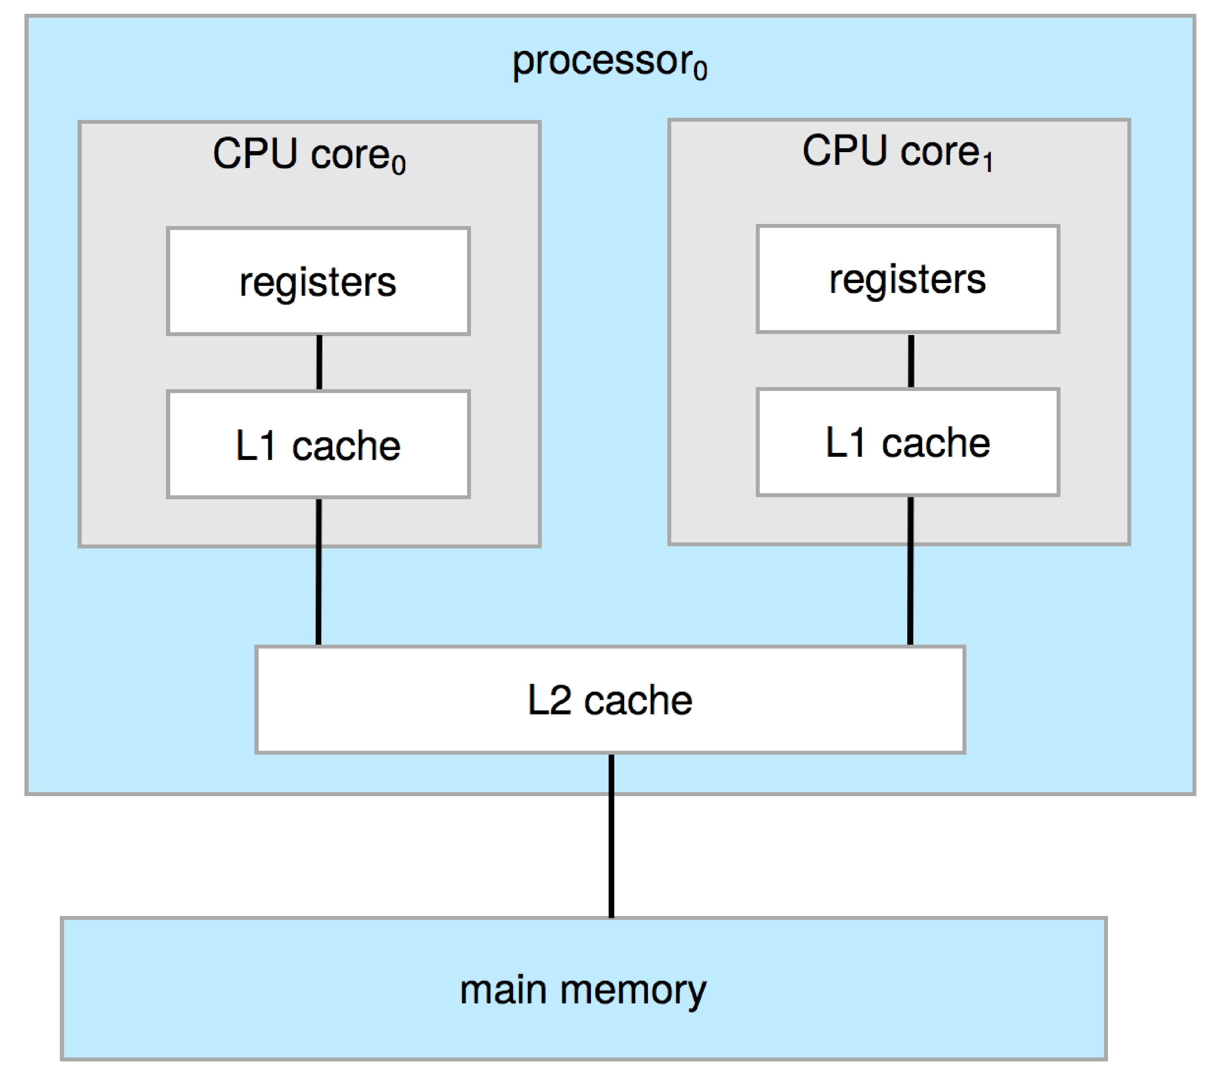
Multi Core

Slide 9
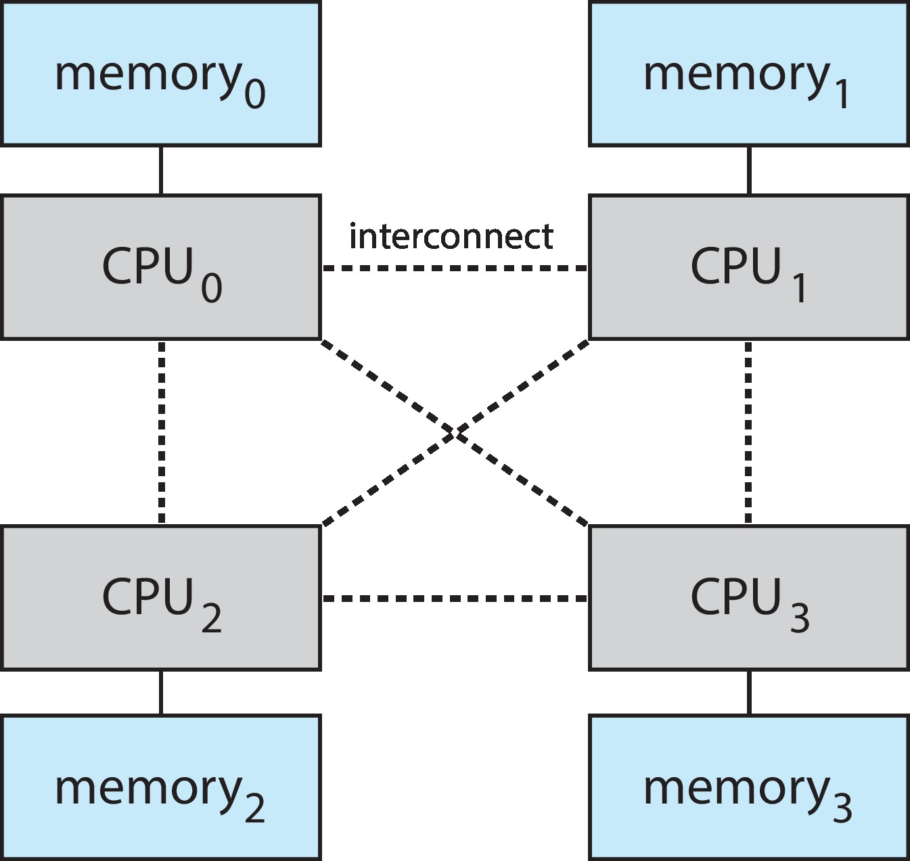
Interconnected Multiprocessors
Challenge:
Non-Uniform Memory Access

Slide 10
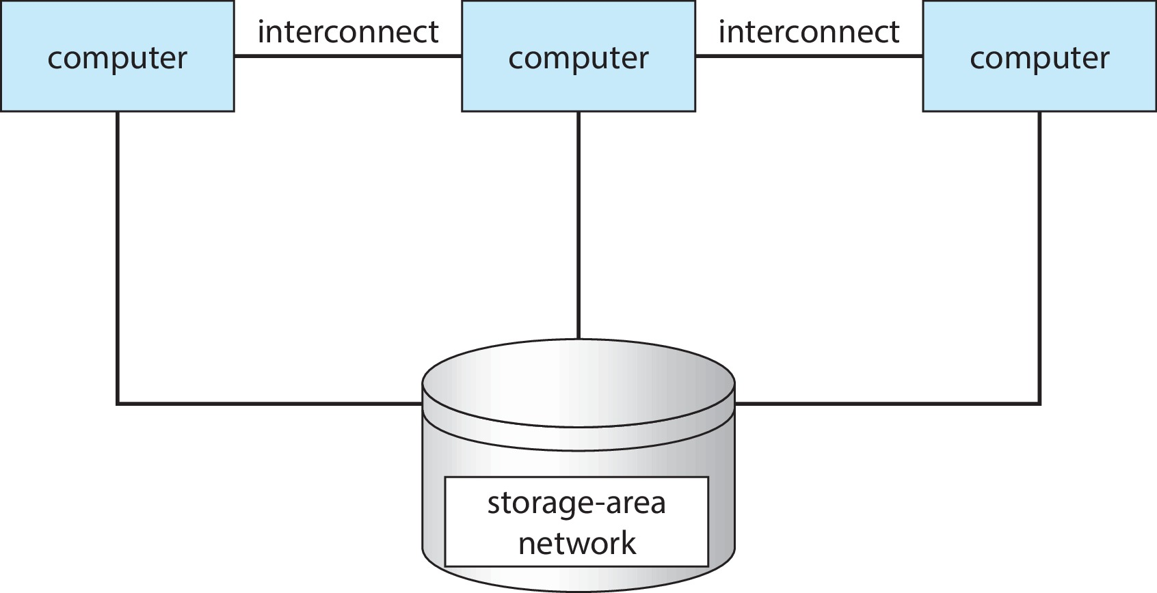
Clustered Systems
Benefits:
Challenges:

